Slide 1
Mon. Discussion Continued…
Q) What qualities in Alexander strike you as unique, exceptional, or critical to the success of his conquests?
-> Now let’s problematize those… Where does that picture of A. come from? Are our sources consistent in depicting it? When we look at actions, rather than representations, does the picture change?
Bertolt Brecht, Fragen eines lesenden Arbeiters (Questions of a Reading Worker):
Wer baute das siebentorige Theben? In den Büchern stehen die Namen von Königen. Haben die Könige die Felsbrocken herbeigeschleppt? ….. Der junge Alexander eroberte Indien. Er allein? Cäsar schlug die Gallier. Hatte er nicht wenigstens einen Koch bei sich? | Who built seven-gated Thebes? In the books are the names of kings. Did the kings drag the boulders there? ….. The young Alexander conquered India. He alone? Caesar defeated the Gauls, Did he not have at least a cook with him?

Slide 2
Military History of Alexander: How to Write it?
1) The Army
Structure
Training
Experience
Logistics
2) Strategy
When, where, and how to engage an enemy
Which enemy?
Capitalizing on your strengths and enemy weaknesses
Luck
3) Tactics
Implementing all of the above in real-time
Leadership, Delegation, Communication
Quick Decision-Making (Boldness; Decisiveness)
4) Politics
Contextualizing the Military
Leadership
*Finally -> Historicizing all of the above

Slide 3
Military History of Alexander: How to Write it?
More Approaches:
Experiential
Experimental
Comparative
Realist vs. Idealist
Other Perspectives (Resistance; Non Greco-Roman sources)
A Military History from Below?
Q) What are some obstacles to writing an objective military history of Alexander’s conquests?
Q) Can a military history of Alexander be situated in the longue durée?

Slide 4
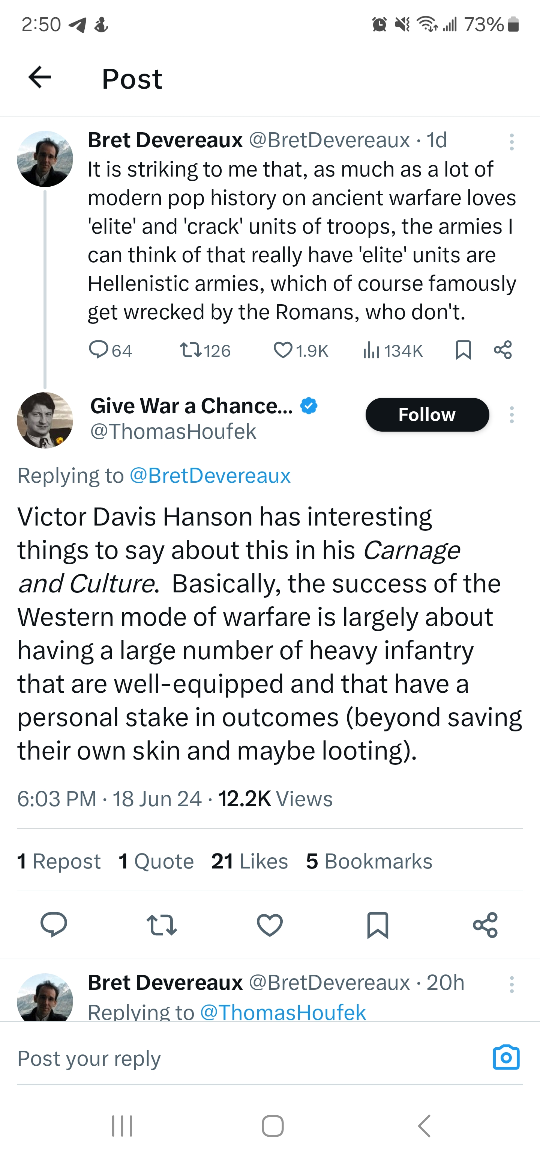
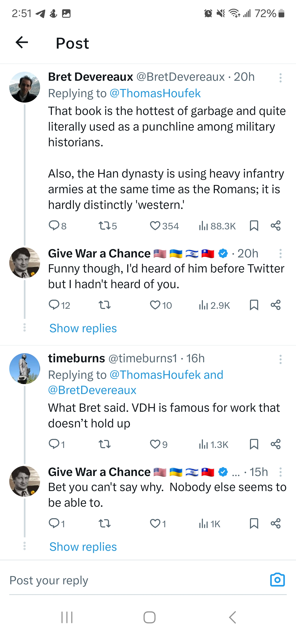
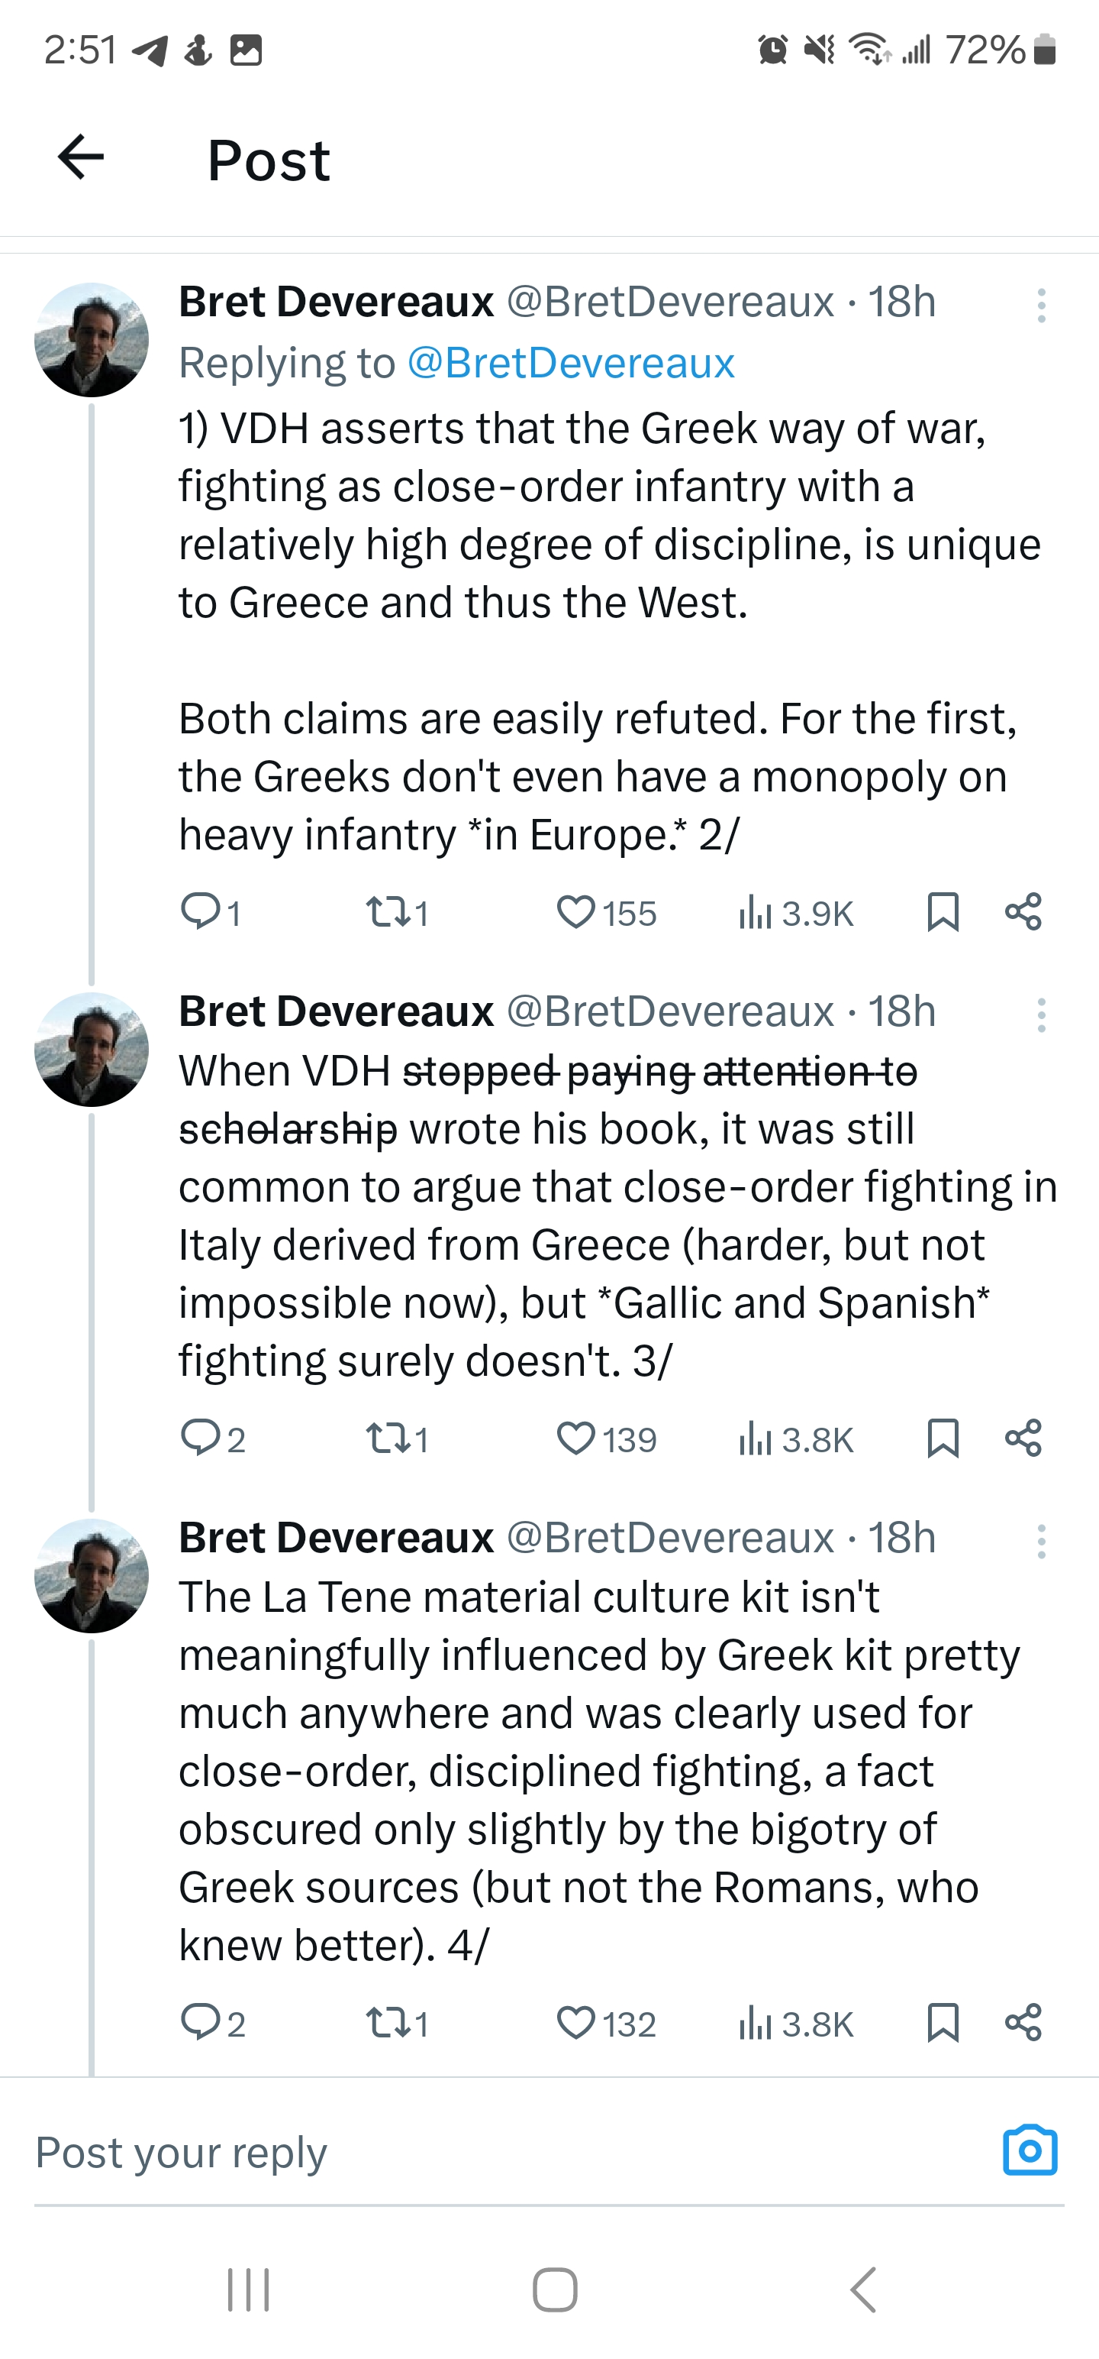

Slide 5
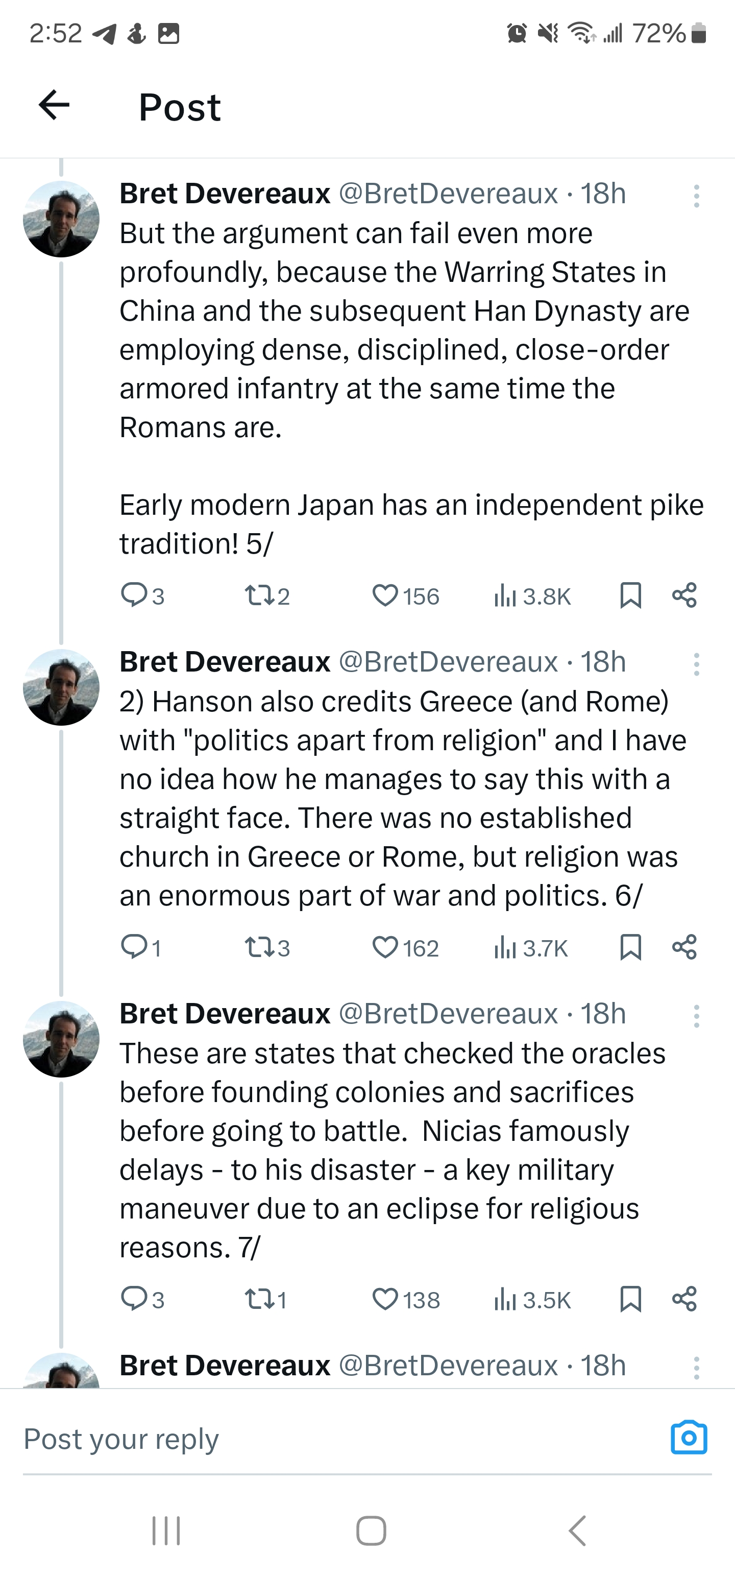
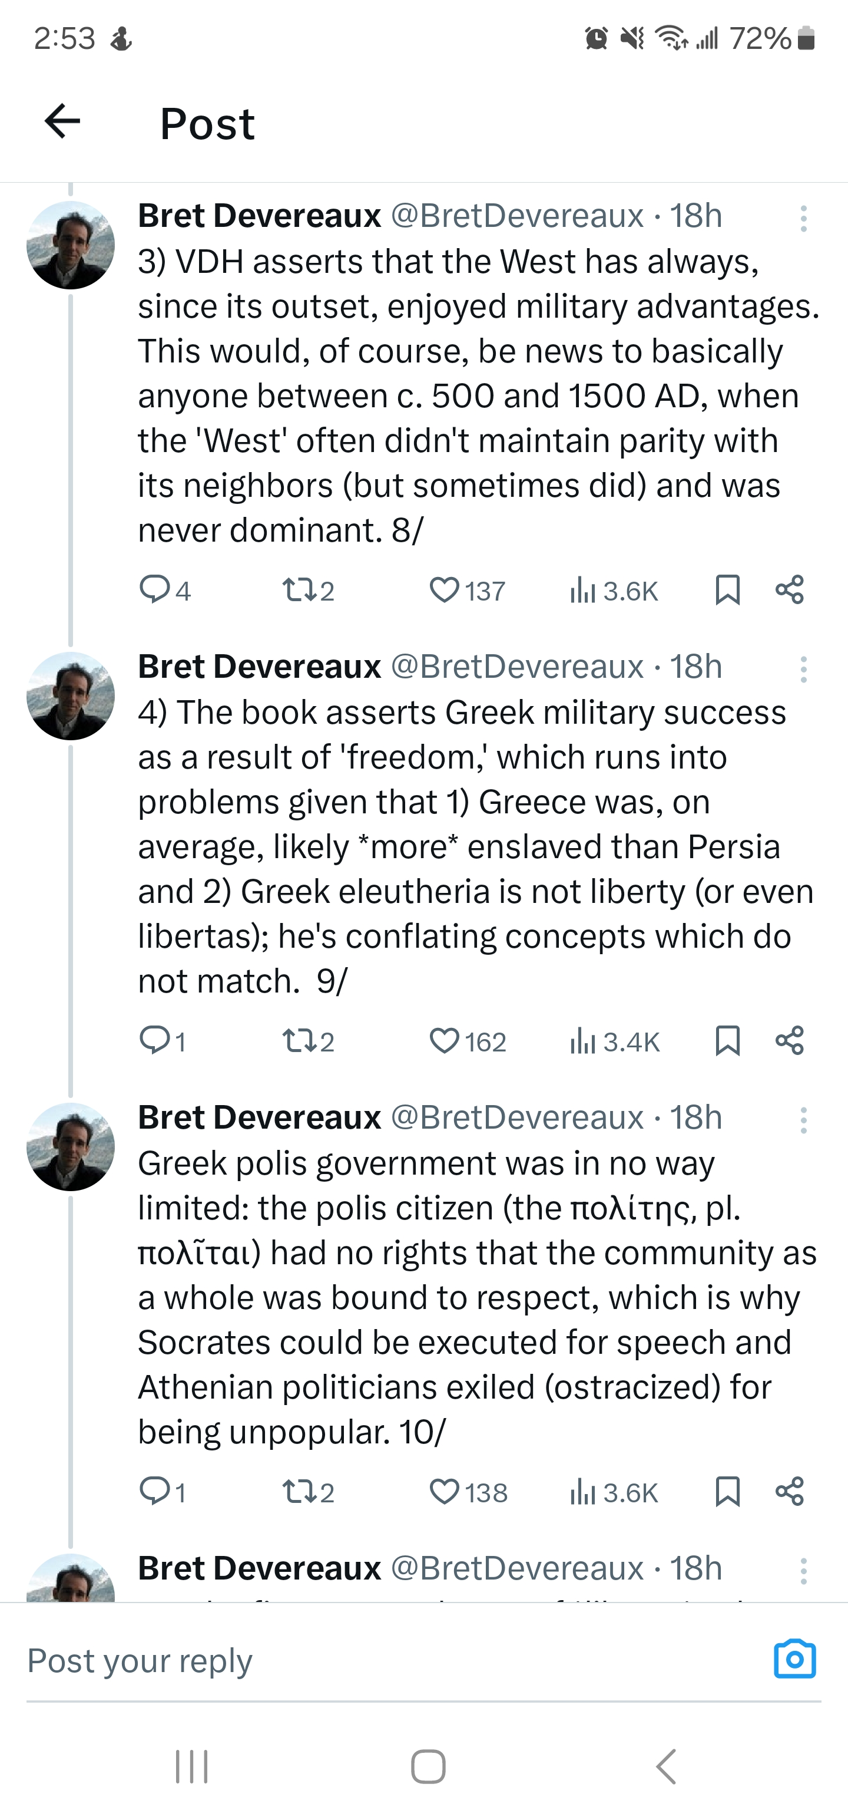
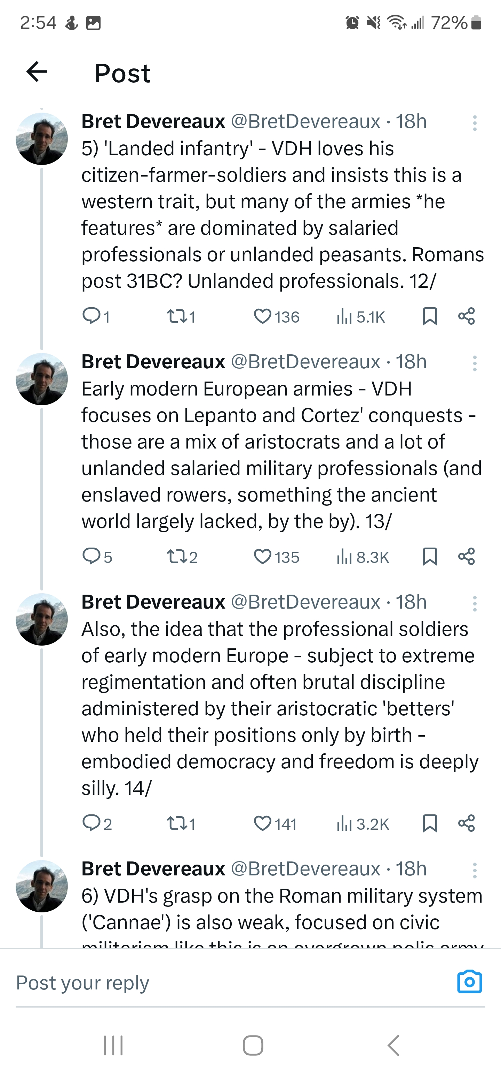

Slide 6
Military History of Alexander: How to Write it?
Innovations (Philip and Alexander):
Cavalry as main attacking unit (Product of social conditions – Landed Aristocracy)
Ratio of cavalry/infantry (Product of social conditions – Landed Aristocracy)
Sarissa phalanx (Product of professionalization, land reforms)
Combined arms -> specialist roles of phalanx, hypaspists, light-armed troops (Agrianians, Archers), cavalry (Theban influence)
Siege technology -> catapults + specialists (Carthaginian/Sicilian influence)
Abortively: the introduction of the war elephant (Persian/Indian influence)
*But some of these were only innovations in the Greek world; Persian armies also drew upon cavalry as their primary forces, and featured a professional infantry core (melophoroi, ‘Immortals’)
Social Structure and Warfare:
The vast majority of Macedonian society was composed of tenant farmers and pastoralists dependent on aristocratic land-owners.
The aristocracy was both the bureaucracy of the state and the core of the cavalry -> the king’s companions (hetairoi).
The sarissa phalanx, the “foot-companions” (pezhetairoi) may have acquired their name via land reforms of Philip which gave them parcels of land and made them loyal to the king.
Even if more of the Macedonian infantry were land-owners, in Alexander’s campaign specifically they became in effect a professionalized corps.

Slide 7
Cultural Geography, or, the Worlds of Alexander
What worlds did Alexander occupy?
First:
Aristocratic/Royal Macedonian Culture
Greek Cultural Education
Why the intense emphasis on Homeric World?
Then:
Egyptian Royal Culture -> Local Control
Then:
Babylonian Royal Culture -> Local Control
Then:
Persian Royal Culture -> Imperial Control
Then:
Indian Philosophers

Slide 8
Cultural Geography, or, the Worlds of Alexander
Alexander and the Greeks
Throughout his campaign, Alexander held games and festivals in the Greek tradition, and was accompanied by a variety of Greek cultural figures (Callisthenes, the sophist Anaxarchus, various Olympic champions).
Alexander carefully controlled his representation in visual arts, apparently only allowing the painter Apelles and sculptor Lysippus to represent him (at least in the Greek world)
He was obviously deeply impacted by his reading in the Greek tradition, particularly with Homer, but also with philosophy (anecdotes re: Diogenes, Calanus)
There is no doubt that Alexander’s conquests laid the groundwork for the rapid and distant spread of Greek culture, e.g. in Egypt, Syria, Bactria, even India. But what indications do we have that this was anything like a deliberate policy?
A very selective approach to Greek historical memory: remember Macedonia sided with the Persians during the Persian wars!

Slide 9
Cultural Geography, or, the Worlds of Alexander
Alexander and the Greeks
For all his embrace of Greek culture, it was also idiosyncratic: the Homeric heroes were fundamental cultural touchstones, but also completely incompatible with democratic ideology.
The historical figure that Alexander most emulated, and was most comparable to, was obviously Cyrus the Great!
Alexander’s treatment of Greek cities was a matter of pragmatism: the destruction of Thebes was a reminder that there was to be no challenge to Macedonian domination.
The justifications of the League of Corinth fall away over the course of the campaign, and his death is immediately followed by rebellion led by Athens and the Aetolians.
Individual Greek cities were dealt with in different ways: some invented connections to Alexander in later history, others had dealings with Alexander documented in inscriptions which are not mentioned at all in the Alexander historians.
An important note: aside from Alexander himself, we lack a Macedonian view.

Slide 10
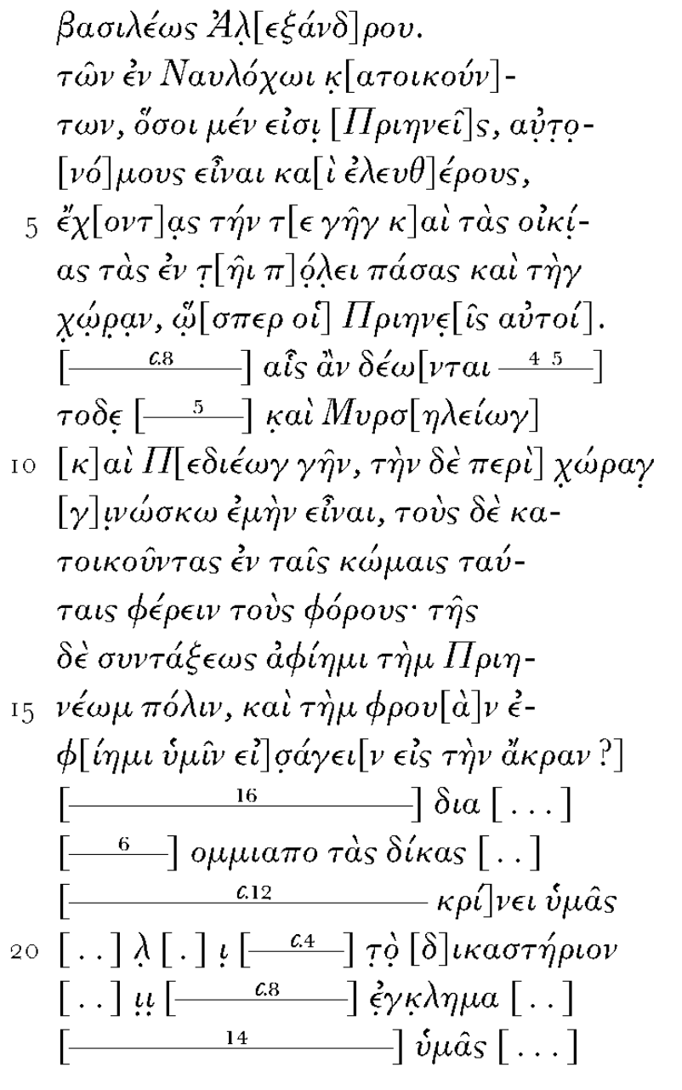
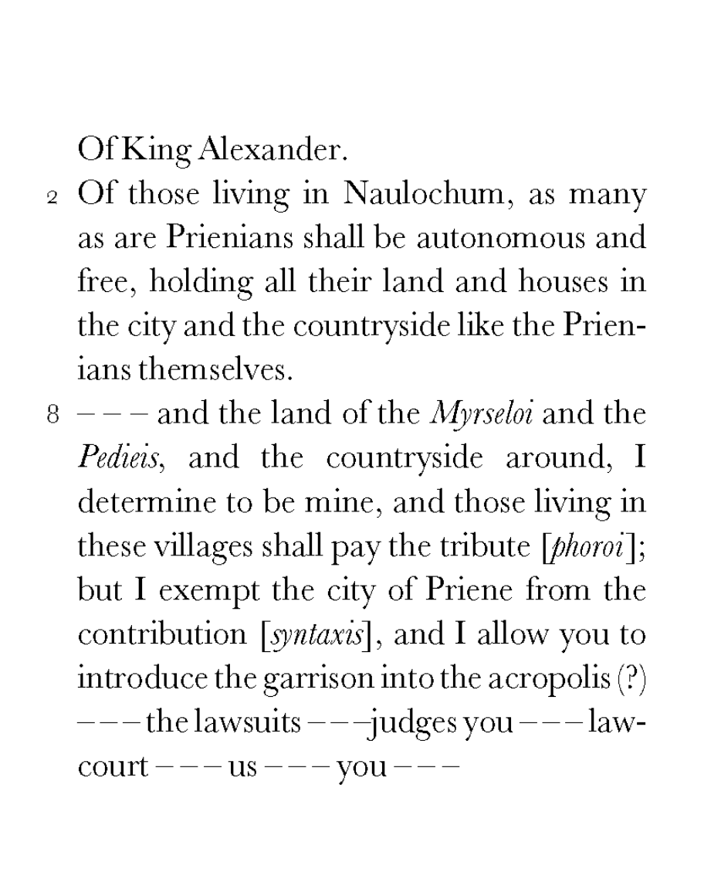
Cultural Geography, or, the Worlds of Alexander
Alexander and Priene
(IPriene 1)

Slide 11
Cultural Geography, or, the Worlds of Alexander
Alexander and Athens
After Granicus (Arrian 1.16.7)
…the prisoners were sent in chains to Macedonia to hard labour, because though Greeks they had violated the common resolutions of the Greeks by fighting with barbarians against Greece. He sent to Athens three hundred Persian panoplies to be set up to Athena in the acropolis; he ordered this inscription to be attached: ‘Alexander son of Philip and the Greeks, except the Lacedaemonians, set up these spoils from the barbarians dwelling in Asia’
Before Gaugamela (Arrian 3.6.2)
“At Tyre he sacrificed a second time to Heracles and held athletic and musical games. There the Paralus from Athens reached him, bringing Diophantus and Achilles as envoys; the entire crew of the Paralus were associated with them in the embassy. They achieved all the objects of their mission; in particular Alexander gave up to the Athenians all the Athenians captured at the Granicus.”
The Exiles’ Decree (324)
- A direct contravention of the League of Corinth’s terms; deliberately weakening Athens by undermining their colony on Samos. Pre/Post Campaign changes evident.

Slide 12
Cultural Geography, or, the Worlds of Alexander
Alexander and the Persian Empire
Arrian 2.14.1-2:
*While Alexander was still at Marathus, envoys reached him from Darius, bringing a letter from him… The letter argued as follows: Philip had been in peace and alliance with Artaxerxes, and when Arses son of Artaxerxes became king, Philip first did wrong to King Arses, although he had sustained no injury from the Persians.
Problems:
Persians stereotyped in long Greek tradition: decadence, luxury, cruelty, unmanliness, tyranny.
Even contemporary sources who were with Alexander influenced by pre-existing Greek representations of Persians: Herodotus, Xenophon -> These established representations of the ‘barbarian’ other contaminate our sources at every level (e.g. (especially) Arrian’s portrait of Darius III).
No Persian historiography as a counterpoint: only scraps of coinage, administrative documents, archaeology (and these esp. scarce under Darius III).
Even modern scholarship (if not so much current scholarship) has been deeply impacted by ancient prejudices, ”west” vs. “east”; “civilizing” etc.

Slide 13
Cultural Geography, or, the Worlds of Alexander
Alexander and the Persian Empire: Scholarship:
Old:
Persian empire as decadent and weak
Darius as cowardly
Un-critical adoption of Greek/Roman biases
Buy-in to “war of liberation”
Alexander as “civilizer”
Alexander’s ”Persianization” as personal flaw
Greek freedom vs. Persian tyranny
New:
Persian empire as dynamic and resurgent in 2nd half of 4th century
Darius as energetic and innovative defender of his empire
A critical awareness of propaganda and biases of sources
Definition of A.’s campaign as expansionist war
Alexander as strategic political pragmatist, not “Persia-lover”
Alexander didn’t destroy the Persian empire, he conquered it
Contradictions in idea that war was about Greek freedom

Slide 14
Cultural Geography, or, the Worlds of Alexander
Case Study: Persepolis
Supposedly a strong exception to Alexander’s growing policy of appeasement/conciliation with Persian aristocracy.
Sources exaggerate the Greek symbolism of destruction of Persepolis Royal palace (Thaïs the Athenian) -> Archaeology shows it was a controlled and deliberate act.
While it might read one way to a Greek audience, the act also had several readings to a Persian audience:
An attempt to intimidate Darius and his supporters
Preventing any rival from claiming the existing throne
Perhaps signaling a return to the Teispid royal line (Cyrus the Great, before Darius I)

